Slide 1

EXPERIMENTAL RESEARCH (300438)
Assignment B1

Slide 2
Starting idea
Do consumers exhibit a below-average effect in consumption?
What affects the strength of this effect?
Does it affect marketing outcomes?

Slide 3
Study 1
How often do you buy the following products compared to other students in your class?
(on a percentile scale from 0 – I buy this the least, to 50 – I’m exactly average to 99 - I buy this the most)
holidays/vacations (M = 35.18, SD = 25.82)
books (M = 41.38, SD = 29.79)
clothes less than others (M = 35.23, SD = 22.22)
go out to dinner (M = 36.98, SD = 25.38)
Notes:
What is the IV and DV here?

Slide 4
Study 2
Bread M = 41.43
Dishwasher detergent M = 36.10
But here we choose these, because bread is bought more frequently. So we predicted that relative rank for Bread > Dishwasher detergent.
Purchase Frequency in Population
+
Relative Rank
Notes:
What is the IV and DV here?

Slide 5
Study 3
 | Negative | Positive
Category | 39.73 | 49.41
Specific | 25.68 | 29.34
Cookies M = 39.73
Stroopwafels M = 25.68
Orchard Fruit M = 49.41
Pears M = 29.34
Product Valence
+
?
Purchase Frequency in Population
Relative Rank
+
Notes:
What is the IV and DV here?

Slide 6
Study 3, simplified
Cookies only | Rank | Loyalty
Category | 39.73 | 4
Specific | 25.68 | 3
+
Relative Rank
+
Purchase Frequency in Population
Loyalty Program
+
Notes:
What is the IV and DV here?

Slide 7
Now, on to your ideas.

Slide 8
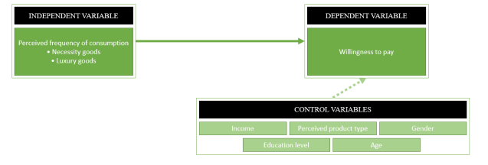
Group 11
Notes:
Luxury is bought less frequent than necessity, and thus stronger below average effect.
DV = WTP. But of course someone is willing to pay more for a luxury t-shirt than a gallon of milk.
But your DV is actually what people think others are WTP, compared to what you are WTP.

Slide 9
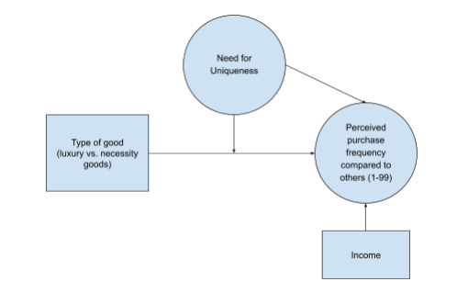
Group 4
Notes:
Luxury goods stand out more, so have a higher perceived purchase frequency compared to actual; and thus a higher relative rank.
High NFU =like shopping mor. More hedonic thus stands out and remembered better. But… can also predict want to be different thus perceive low relative rank.
Have a moderation prediction, but ask to explain.
But manipulation watch (luxury) versus food has also an actual difference in frequency.

Slide 10
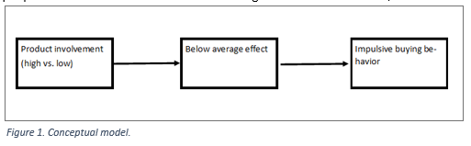
Group 2
Notes:
- Low involvement makes it likely that people underestimate how often they buy something.
Low involvement leads to more impulse buying.
Agree. But why predict below average -> impulse buying? Should it not be the other way around?
Manipulation: shoes versus coffee. They differ on frequency…
Verification question to check whether it “works” for an individual. How to use? (risk of selection bias!)

Slide 11
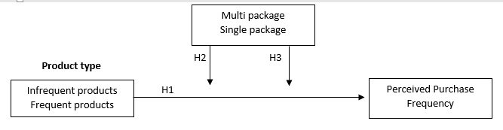
For our research, we will use a 5- point Likert scale which gives the respondent the five following answer options:
1. ‘I never buy the product’
2. ‘I rarely buy the product’
3. ‘I occasionally buy the product’
4. ‘I frequently buy the product’
5. ‘I always buy the product’
Group 12
Notes:
Multipack could go both ways: buying multipacks of cigaretets might make the consumption more salient, and therefore remembered better. But it also becomes less frequent, which would lead to a stronger below average effect. But is this a main effect or a moderation?
I quite like the frequency manipulation (how often do you buy product x? vs how often buy eco-version of product x?
Nice idea: people buy less packages of beer than bottles of beer. Will that affect the below average effect?
DV: not a good measure of the below average effect. Good enough to detect effect of the IV; but not to establish whether there is a below-average effect.

Slide 12
Availability heuristic: people overestimate things that come to mind easily
Premium brands stand out more than private labels, which makes it likely that the purchase of private labels is underestimated more than that of premium brands.
Manipulation check: how easy or difficult it was to recall this.
Group 5
Notes:
Coca Cola versus private label cola.
Mediation with manipulation check.

Slide 13
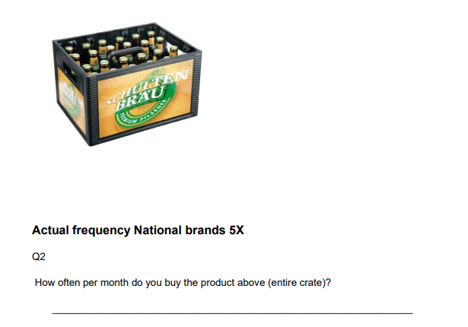
Similar idea; but now from the idea that premium brands are seen in a more positive light than private label. This is why people will likely underestimate their rank more for private label.
2x2 design with private/premium & actual frequency/relative rank (?)
Group 10
Notes:
Coca Cola versus private label cola.
Mediation with manipulation check.

Slide 14
Alternative explanation for frequency effect:
System 1 (intuitive) and System 2 (analytical).
Frequent products are also bought more via System 1 processes; therefore estimating frequency feels easier, which leads to more above average effects.
Products bought via System 2 are more difficult & bought more infrequently, but the below average effect is driven by the difficulty of these purchases.
Manipulation laundry detergent versus washing machine
Group 14

Slide 15
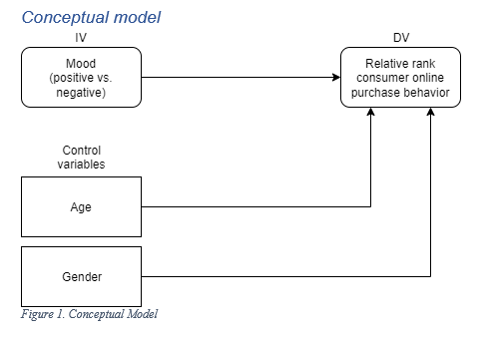
Group 6
Notes:
Positive mood more impulsive, negative mood more planned. But why will it affect relative rank? Students are also open on this.
Manipulation with reading news article. All the same, except positive / negative mood? (active/passive?)

Slide 16
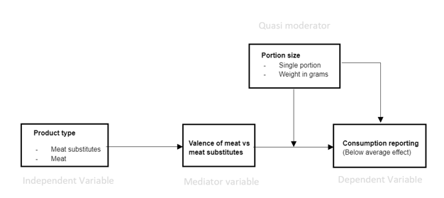
Group 7
Notes:
More difficult to compare in weight numbers (less common), which likely leads to stronger underestimation
Valence has an effect (vega > meat, so stronger below average effect for meat).
Moderator?
(my prediction; because we’d want to be “better”consumers, we can perhaps more easily use the vagueness of the weight estimate for motivated reasoning. Therefore, stronger weight versus portion effect for meat than for vega>

Slide 17
Some products are taboo; e.g., sex-related items
Compare relative rank for taboo products (condoms, lubricant, pregnancy tests, morning afterpil, sex toys) to general products (toothpaste, shampoo, socks, clothespins, candles).
Measure perceived tabooness.
+
Perceived Tabooness
-
Sex (vs other products)
Relative Rank
Group 8
Notes:
But… problem is also that probably those that find it less of a taboo also actually buy it more.
Good idea, but perhaps find different way to manipulate?
More broadly; I could not directly find a test of perceived relative rank for number of sex partners: what is your prediction? An above or a below average effect? Would this differ by gender?

Slide 18
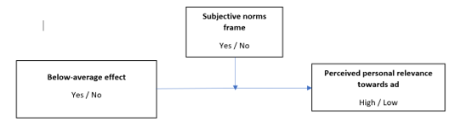
Lottery ticket > $30
Lottery ticket < $5
Former more rare, thus manipulation of
Below average effect
Group 9
Notes:
Main question that I did not get from proposal: what is the DV? What is the prediction there?
But, problem is of course that they actually buy the > $30 less and is thus less relevant (not only less perceived relevant).
Subjective norm frame: nothing versus gambling is bad.
Effect of subjective norms on perceived relevance?
Close to valence that we did before. But here you highlight the valence after the relative rank estimate.

Slide 19
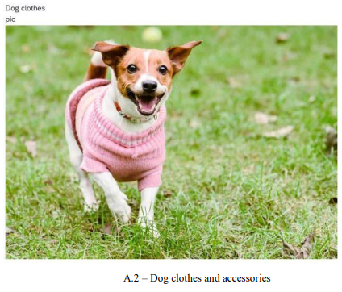

+
Guilt
-
Hedonic (v functional)
Relative Rank
IV: Think about spending on dog food (functional) or dog clothes & accessories (hedonic).
DV: How much do you spend on this compared to other dog owners?
Mediator:
Group 2
Notes:
Control variables needed? (e.g., size of dog?)
Mediator is personality trait(!)
Perhaps a moderator?

Slide 20
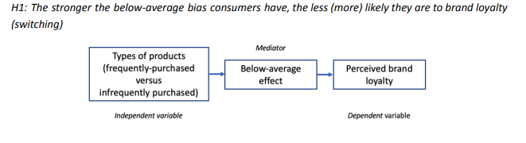
Group 13
Notes:
If you realize that you buy a product more than others, switch brands less. Heavy users are more loyal.
Does the below average effect trigger more switching than if they realized that they were more above average?
I could see how heavy users are likely to stick to a brand. But why would the below-average effect have an additional effect on this?
Or is there a moderator? (NFU?)

Slide 21
Qualtrics do’s and don’ts

Slide 22
Order of the questions: IV – Mediator -- DV. After the manipulation, DV should be asked first most of the time, then the process variables. If we ask the mediator question before the DV question, how do we know that the realized effect is observed because of the IV? (even better: counterbalance the order)
Does the process measure mean the same thing in different conditions/choices?
Example → DV: How likely is it for you to donate to the charity? Process variable: To what extent your decision was affected by anticipated guilt?

Slide 23
Allowing the participants to skip important questions. Forcing participants to answer all of the questions might not be the most ethical thing to do, but at least having them answer the most important questions is important not to end up with a huge amount of missing variables. -> “request answer”
Asking irrelevant questions
A survey containing as few questions as possible is the best. Therefore, any question that does not serve the main research question or provides some importance for exploratory reasons should be discarded.

Slide 24
Randomization function: Not selecting ‘evenly present’ might lead to an unproportionate accumulation of the participants across conditions.
Poor instruction (especially for the open-ended questions). This is important for participants to indicate the most accurate answers and also for you to handle the data accurately after the data collection. Example: How many times do you buy this product in a month? (Please indicate the approximate number of packages you buy in a month in numbers, e.g., 5, if you do not buy, please enter 0)

Slide 25
Ordinal measures that have overlapping endpoints. The options provided for an ordinal measure should not overlap each other. Example: Income levels: 0-$1000, $1000-$2000: which one I should choose If my income is exactly $1000? It is better to indicate the second option as follows: $1001-$2000

Slide 26
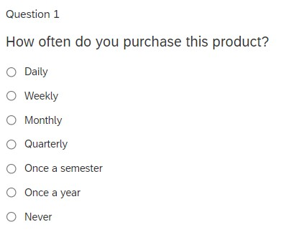
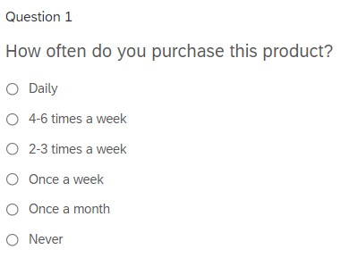
Measuring the same variable differently in the different manipulations In different manipulations (e.g., control group vs treatment group) sometimes we have a slightly different framing for the DV measure for the sake of the manipulation consistency. However, the measures should stay the same so that we can allocate the data and analyze it properly. Example:

Slide 27
Inadequate briefing for the concepts mentioned in the survey. If you are going to test a construct or a concept that might be known already, it is still better to explain what you mean exactly while talking about this construct/concept. Example: People might get different meanings when they are told to think about “meat substitutes” or they may not know the concept at all. Giving them a clear definition for what you mean will help.

Slide 28
Tips for Better Usage of Qualtrics

Slide 29
1- Typical structuring the survey with separate blocks. Part 1: Introduction & Consent. Part 2: Manipulation. In one block, or in 2? Part 3. DV, process, manipulation checks, control variables. How to link to Part 2? Part 4. Demographics, perhaps open box to respond to survey Part 5. Thank you, perhaps debriefing, and how to finish.

Slide 30
2- Using page breaks between questions, especially between DV and process variables Firstly, via page breaks, you can avoid affected answers. Besides, that will provide a nicer survey flow for the participants, and also prevent them to feel overwhelmed with a bunch of questions on the same page. 3- Asking the demographics & control variables in the end Not to overload participants before getting to start the main survey, keep the demographics and control variables at the end of the survey.

Slide 31
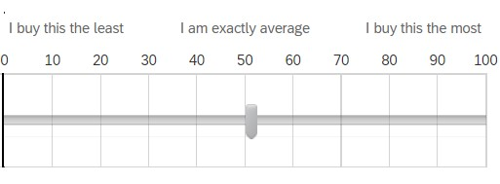
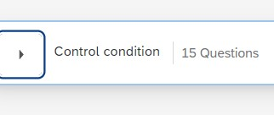
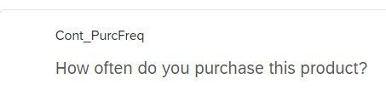
4- Put labels on the scale (mid and endpoints) Putting labels on the scale will help the participants to indicate their answers. Example: 5- Name the blocks and questions. Giving labels to blocks and questions will make them understandable for everyone. Besides, when you download the data, you will have a better comprehension which column corresponds to which variable. Example 1: Name for the question Example2: name for the block

Slide 32
6- Randomize the order of within-subjects questions. If you are going to show multiple stimuli (e.g., products) in each condition, then randomizing their display order might help you to have unbiased results. 7- Use the “request response” function for the main questions. You can arrange the following setting: Click on the question, and you will see on the left-hand side ‘Response requirements’. Select request response.

Slide 33
Assignment B2
(record)

Slide 34
Idea 1 Inspired by multi package idea (items > packages): - We consume products more often than we buy them. - We know that frequency matters (in that more frequently purchased goods show less strong below average effects) Will the below average effect be less strong for consumption than for purchases?

Slide 35
Idea 1 We also use two different products as the target product: one product for which consumption is about the same as purchases, and one for which the package contains a lot of units to consume. - How often do you buy a coffee to go compared to others? - How often do you drink a coffee to go compared to others? - How often do you buy coffee for home use compared to others? - How often do you drink coffee at home compared to others?

Slide 36
Idea 1 If frequency matters, we should only find an effect of consumption versus purchases on relative rank for coffee at home (not for coffee to go). If consumption itself (compared to purchases) has an effect, we should find it both for coffee at home & coffee to go.

Slide 37
Idea 2 Inspired by your ideas on premium vs private label: Is the below average effect stronger for private label products than for their premium label equivalents?
And does this affect people’s WTP compared to what they think the average person’s WTP is? We measure the WTP of the participant, and ask them to estimate the WTP of the average person. The variable for the analysis becomes WTP average person minus WTP self.

Slide 38
Idea 3 Inspired by your ideas on the effect of brand loyalty. Does people’s relative rank affect their brand loyalty? We try to manipulate their perceived relative rank and measure brand loyalty.
Let people estimate their relative rank for the purchase of a product,
For half the respondents we then tell them that people typically underestimate their rank by on average 20 points.
Then measure their brand loyalty /likelihood to switch

Slide 39
Idea 3 We try to manipulate their perceived relative rank and measure brand loyalty.
Subsequently: Does Need For Uniqueness play a role? - prediction: NFU negatively relates to perceived relative rank - Does NFU moderate the effect of consume/purchase on perceived relative rank?

Slide 40
Idea 3 NFU (short form, Ruvio et al., 2008), Avoidance of similarity subscale: - When a product I own becomes popular among the general population, I begin to use it less. - I often try to avoid products or brands that I know are bought by the general population. - As a rule, I dislike products or brands that are customarily bought by everyone. - The more commonplace a product or brand is among the general population, the less interested I am in buying it.

Slide 41
Assignment B2 For 2 of these 3 ideas I’d want your group to: a) draw the theoretical model of your predictions in a boxes and arrows model to highlight the predictions. b) write a methods section, so a reader could understand what the study did with sufficient detail (as if it were a scientific article) c) write an analysis section, testing the key assumptions.

Slide 42
Assignment B2 To further add: - the original data file you downloaded - the data workfile you eventually used, or the R code that got you from the original datafile to the working data you select for the analysis - the code for the analysis; either the SPSS syntax or the R code. - the output of the analyses Combine all these again in a zip-file and upload it as assignment B2 in Canvas.
- A powerpoint slide (with group number on it) for each study where you try to display what you think is the most interesting finding / result. Visualizations are nicer than text!

Slide 43
Assignment B2 Deadline: May 30, 16.00 Ceren will plan feedback sessions (probably May 26). We probably combine 4 groups into a 30-minute session.

Slide 44
Enjoy!

